Slide 1
Customer Lead Prediction
By – Rajadurai DJ

Slide 2
Table of Contents
Problem Statement | To find the Which leads are most likely to convert into paying customers?
Tools Used | Power BI, Python
Approches | Prospects Converted
EDA Insights | Conversion by which source of marketing (Conversion)
Conclusion | Final review of prediction
Suggestions | Own inputs

Slide 3
Problem Statement
The online Edu-Tech platform that generates leads through various sources. The marketing and sales teams want to optimize their lead conversion rates and improve the efficiency of their lead management process. The primary goal is to predict whether a lead will be successfully converted into a customer or not. This prediction can help the Edu-Tech company to prioritize leads with the highest conversion potential and tailor marketing and sales strategies accordingly. The analysis and prediction (optional) will be based on the information available in the provided dataset.
To predict the correct accuracy rate of conversion from prospects, use historical data analysis, machine learning models.
And key metrics such as engagement, demographics, and past conversion rates to refine predictive accuracy.

Slide 4
Tools Used
Used Excel for cleansing data, improving data quality by removing errors and duplicates, ensuring accurate analysis, and enhancing overall understanding for better decision-making.
To identify relationships between data using Power BI, leverage its visualization tools. Import data sets, create relationships via data model views, and utilize charts, graphs, and DAX formulas to uncover insights
To predict accuracy, I used Python packages such as pandas for data manipulation, numpy for numerical operations, matplotlib for visualization, and implemented scatter plots and linear regression for predictive modeling and analysis.

Slide 5
Approches
The dataset was segregated into four distinct patterns using Power BI. This segmentation facilitated better understanding and analysis by categorizing data based on key characteristics, revealing insightful trends, and enhancing decision-making.
Approached the raw dataset with various suitable visualizations, such as bar charts, line graphs, scatter plots, and heat maps, to enhance understanding and extract meaningful insights effectively.
Conversion
Leads By
Site Activities
Prospects Details

Slide 6
- Prospects Details
The total number of prospects is 9,240, providing a comprehensive base for analysis and strategy formulation.
Most of the leads belong to Mumbai city, highlighting a significant regional concentration for targeted marketing efforts.
Most of the leads were unemployed, with only 12% being working professionals, indicating a significant portion of the target audience is seeking employment opportunities.
Nearly 31% of the lead sources are from Google Search, indicating strong online visibility and search engine optimization efforts.

Slide 7
- Site Activities
Nearly 37% of leads show Email Opened, and 27% of prospects have SMS Sent as their last activity on the online platform.
Most customers heard about X EDUCATION from the select category, while only a few intended to search for it themselves by individually

Slide 8
- Leads By
Only 5 prospects were successfully converted in this dataset.
Prospects were equally sourced through both magazines and newspapers, resulting in a balanced distribution of leads from these two traditional media channels.
Out of 9,240 total prospects, 9,103 were from page view.

Slide 9
- Conversion
Most conversion rates originated from Mumbai, India, highlighting the city's significant contribution to successful conversions in this dataset.

Slide 10
—EDA INSIGHTS

Slide 11
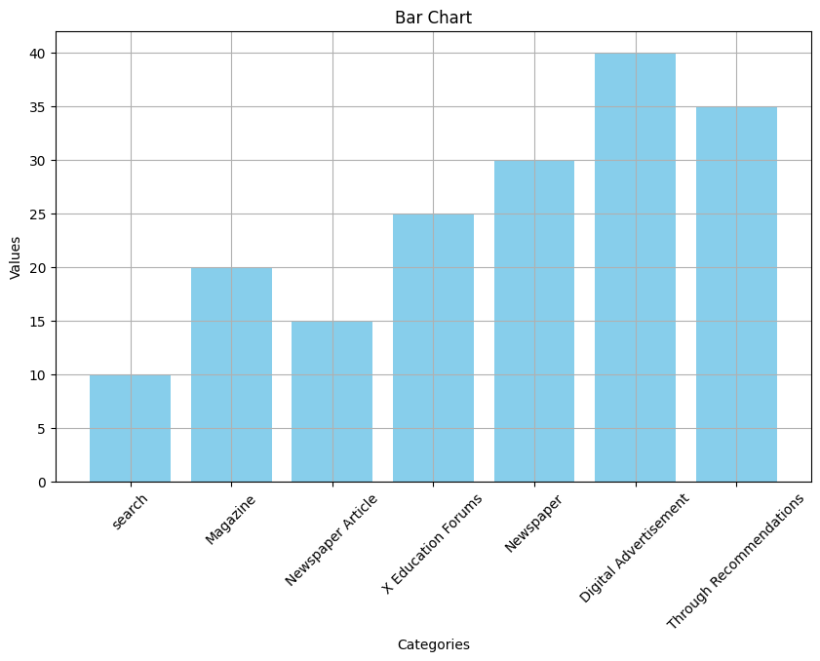
Advertising Platforms
Digital advertisement & Through recommendations has made a more marketing play for generating leads
And newspaper listed in 3rd place

Slide 12
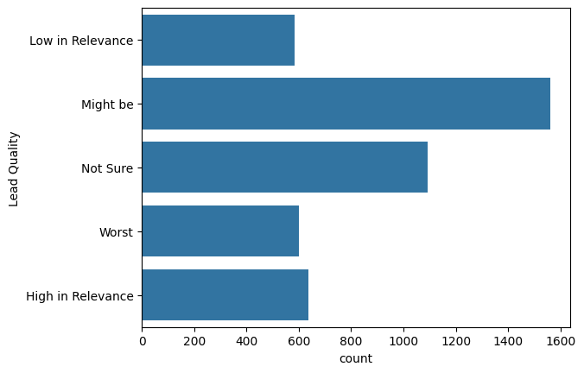
Lead Quality
A might be category indicates more than 1500 are chances to be converted.
And Not sure title indicates somewhat same little similar values with might be.

Slide 13
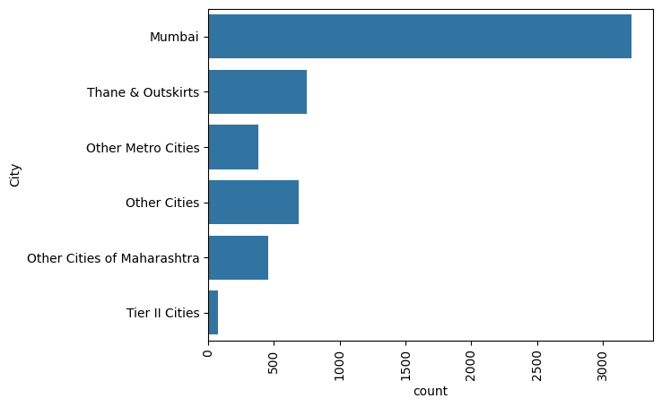
City Wise
The Mumbai city indicates more leads are to get converted

Slide 14
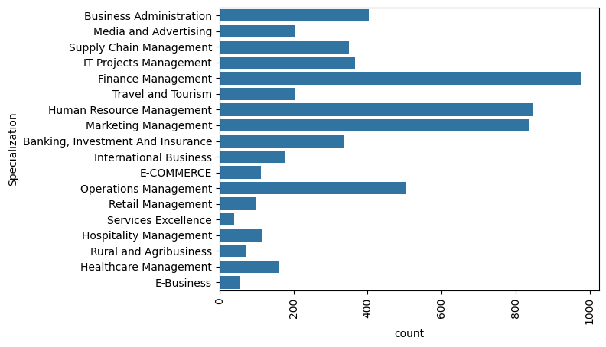
Specilization
The Financial Management students are opting more compare with other specialization
And Human resource & marketing management comes in second.

Slide 15
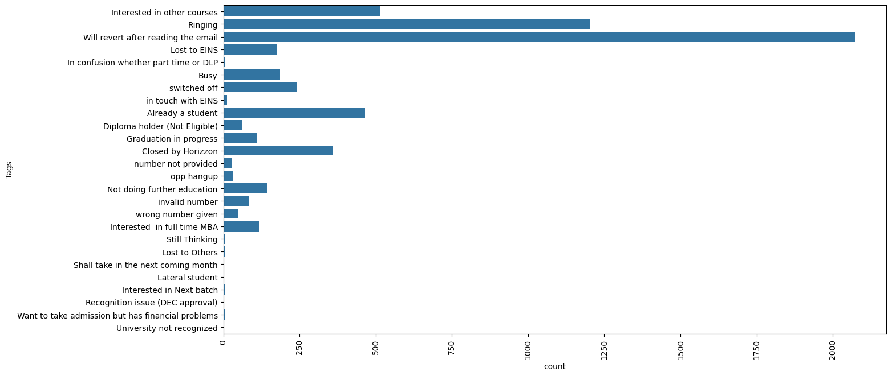
By Tags
More leads are choosed will revert after reading the mail

Slide 16
Conclusion

Slide 17
The dataset, which comes from an education organisation, includes information about leads that prospective customers have created for the business's goods and services. We must apply EDA on the provided data in order to draw conclusions from it.
We employed a box plot and count for the graphical EDA. We drew conclusions for non-graphical EDA using value counts, ratios, etc.
Performing exploratory data analysis (EDA) to derive insights such as identifying the best performing value in each column, determining which value generated the most and least leads, and uncovering relationships between columns, etc.

Slide 18
Suggestions

Slide 19
“Mumbai” generated the maximum number of leads, but the conversion ratio was just 32.24%
An advertising statergy should focused more.

Slide 20
Thanks!

